Slide 1


What did I do today?

Slide 2
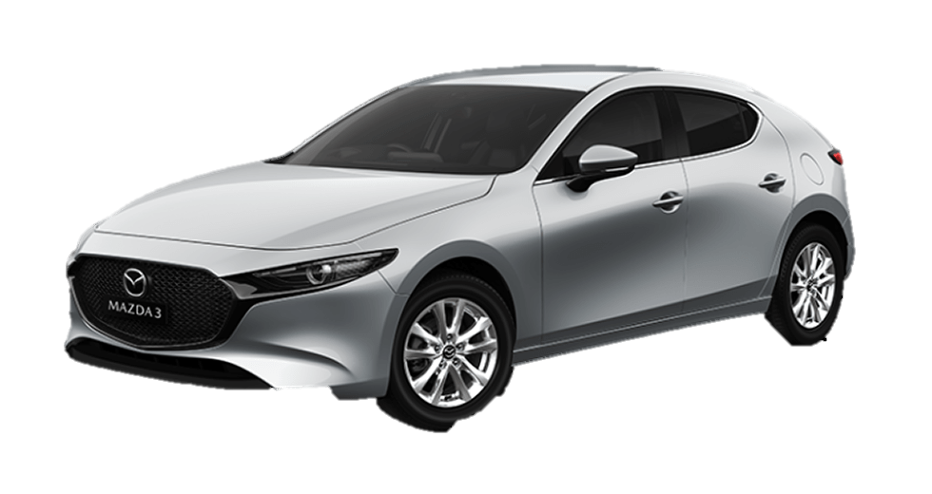
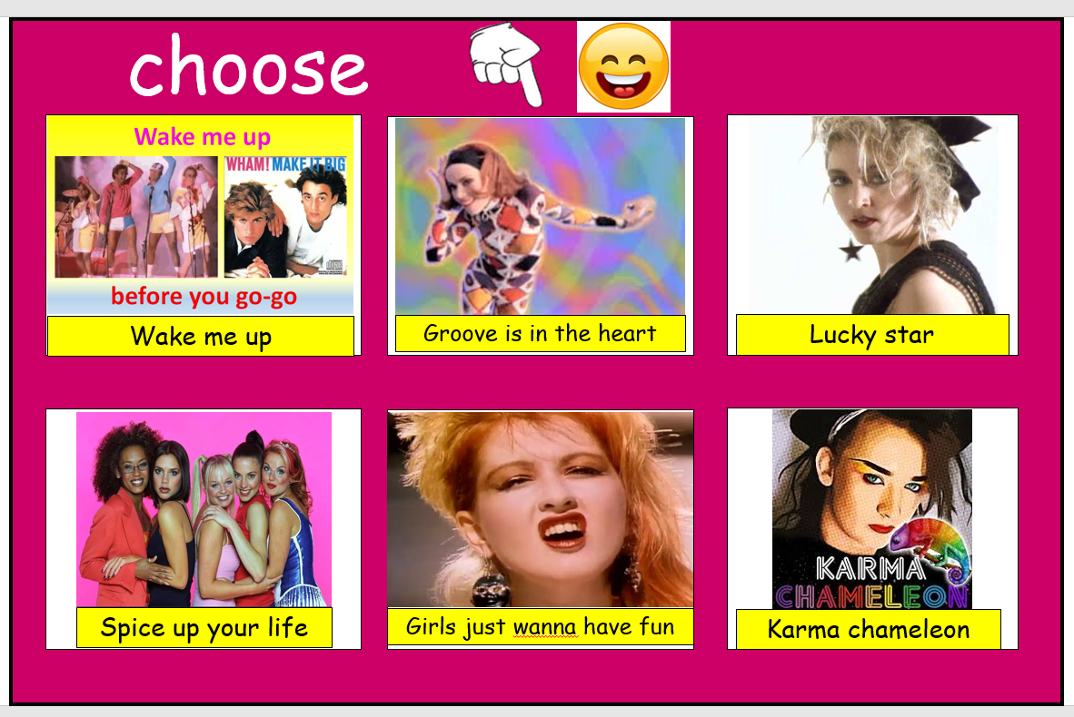
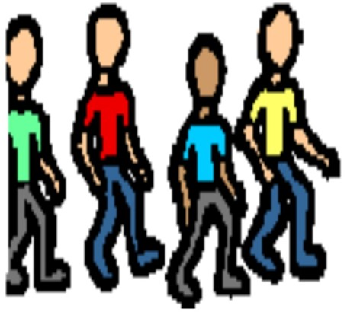

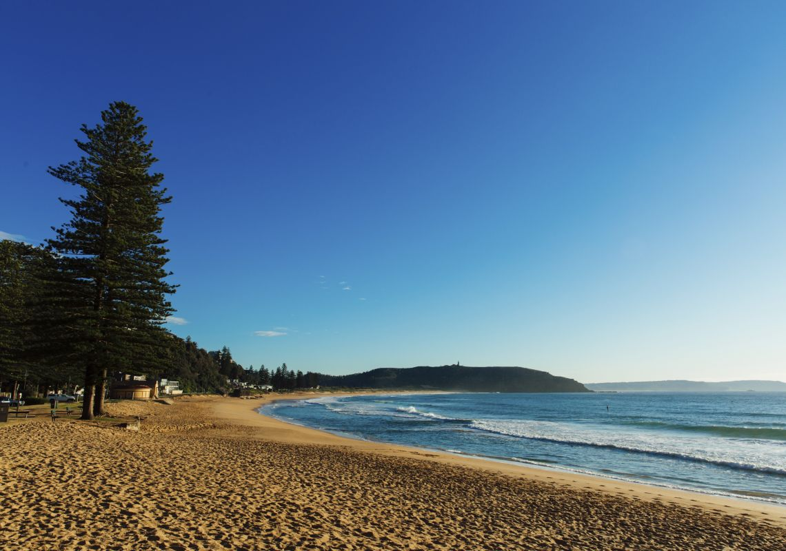

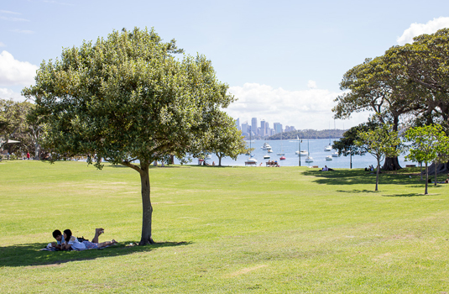
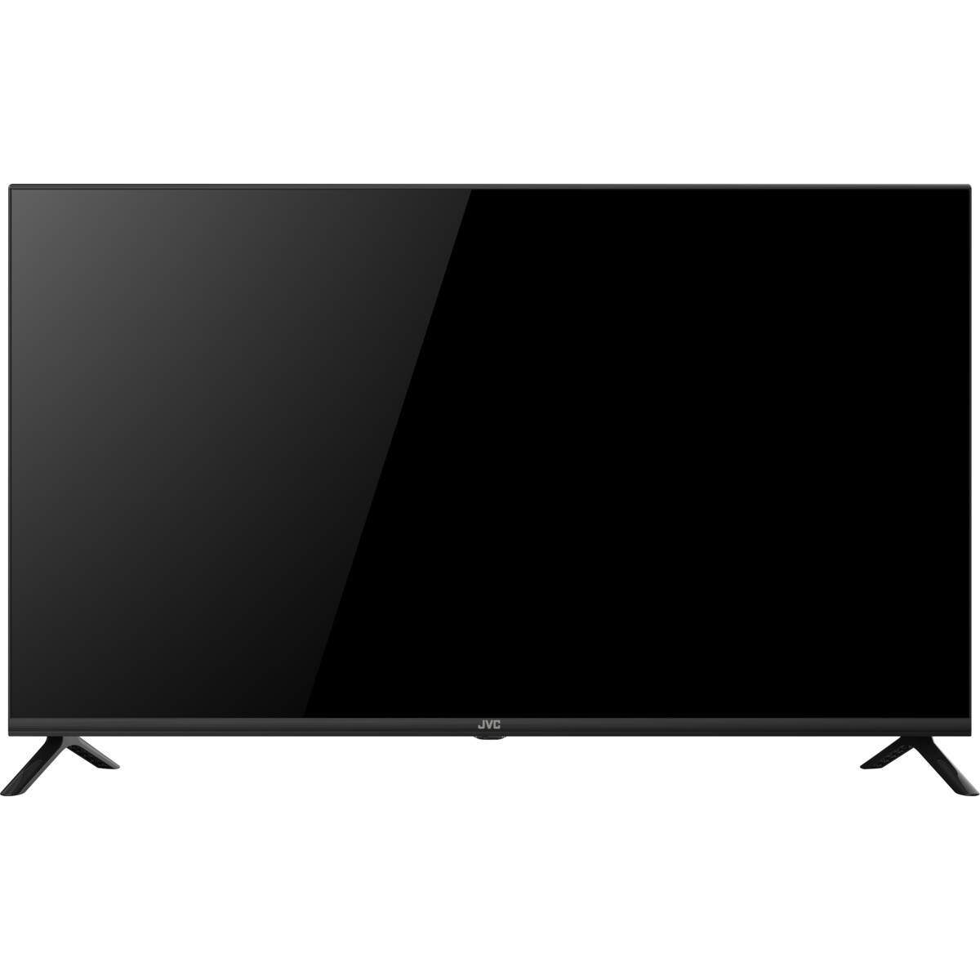
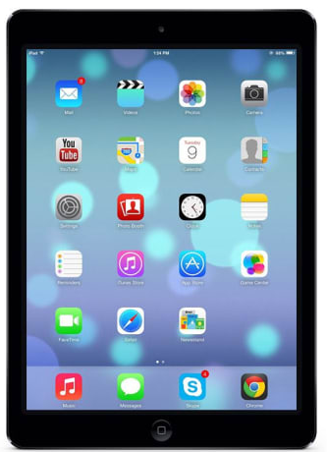
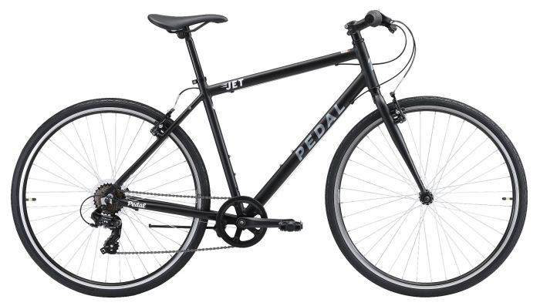

Today is
What did you do today?
drive in the car
music choice
walk
What did you see?
cooking
Who did you go with?
beach
Draw a picture
movie
park
iPad

Slide 3


Today is
What did you do today?
music choice
drive in the car
walk
cooking
beach
Who did you go with?
movie
park
iPad

Slide 4

Today is
music choice
What did you do today?
drive in the car
walk
cooking
beach
movie
park
iPad

