Slide 1
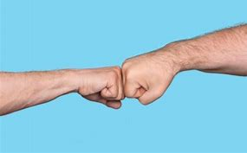

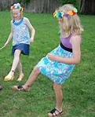


with our friends and helpers it is safe to
Fist bump
wave
Foot shake
safe
safe

