Slide 1
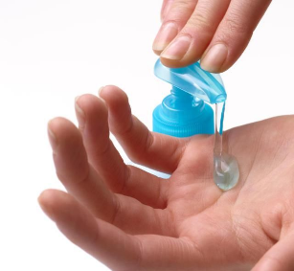
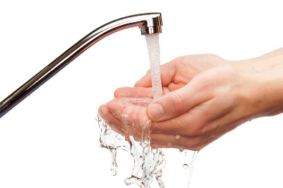
1
2
wet hands
soap hands

Slide 2
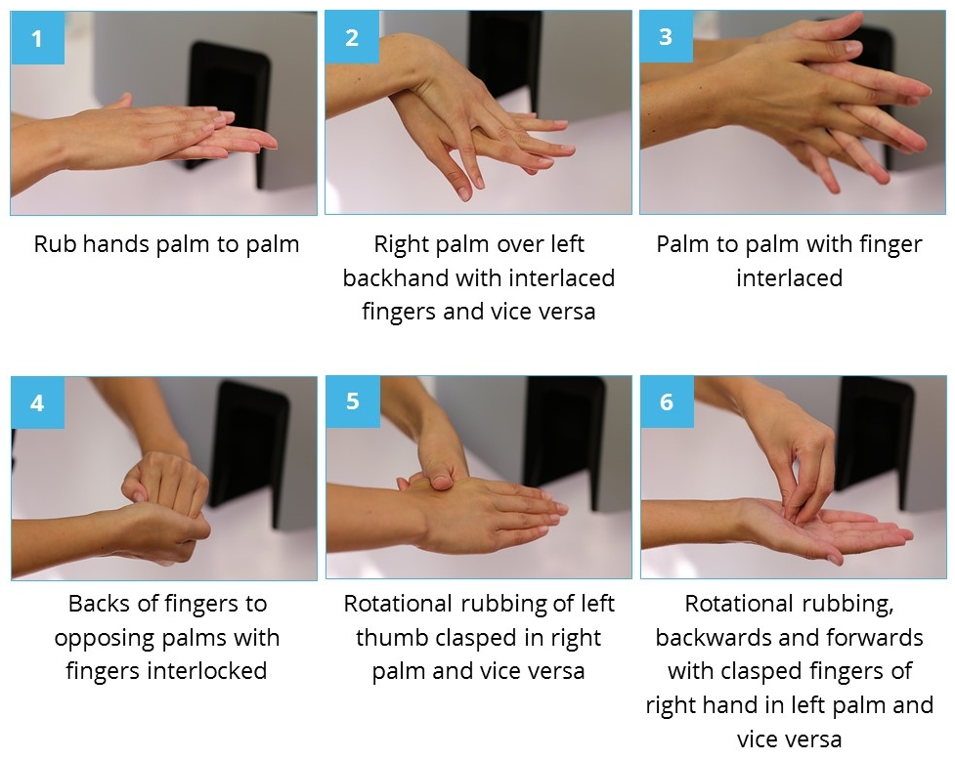
3
scrub palms
scrub fingers on top
scrub fingers together

Slide 3
4
scrub knuckles
scrub thumbs
scrub nails

Slide 4
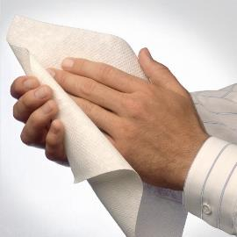
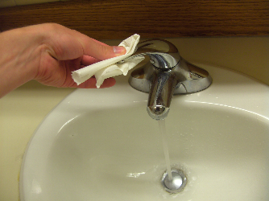
5
6
7
wet hands
tap off with towel
dry hands

